Slide 1

Exam SC-200: Microsoft Security Operations Analyst Crash Course
Tim Warner

Slide 2

Tim Warner
Based in Nashville, TN, US
Central time zone
Senior Content Developer, Microsoft
MCT, former MVP
Twitter: @TechTrainerTim

Slide 3
Day 1 of 2 Agenda
Introduction
Microsoft 365 Defender

Slide 4
Day 2 of 2 Agenda
Content catch-up
Microsoft Defender for Cloud
Microsoft Sentinel

Slide 5
Course Materials
timw.info/sc200

Slide 6
Course Expectations
Please review the recordings…several times!
10-minute break at midpoint
I’m here to answer your questions – take advantage of this
Use the Q&A panel

Slide 7

Session Recordings

Slide 8

Session Recordings

Slide 9

Session Recordings

Slide 10


Mobile Browser: learning.oreilly.com

Slide 11



O'Reilly Mobile App

Slide 12
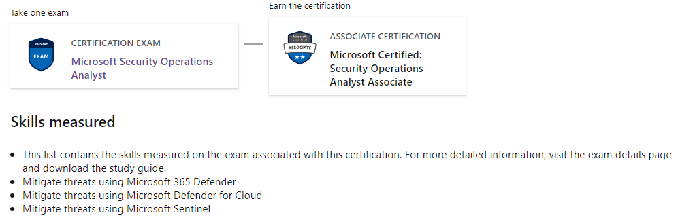
Security Operations Analyst Associate
SC-200

Slide 13
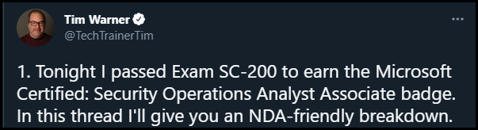

Slide 14
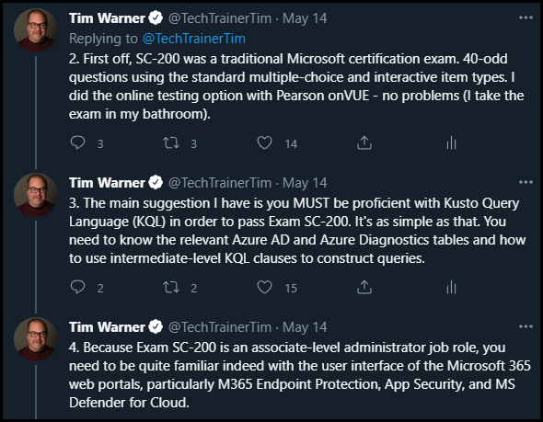

Slide 15
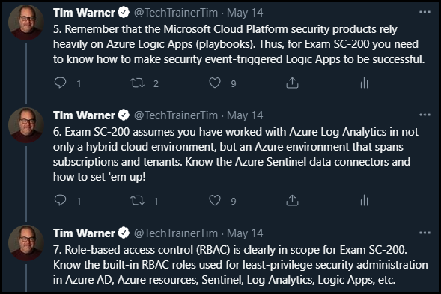

Slide 16
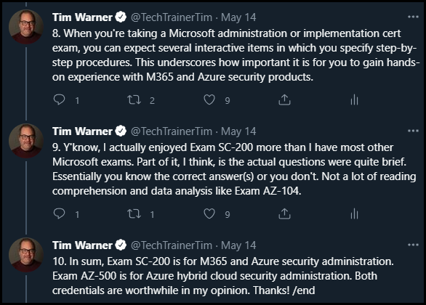

Slide 17
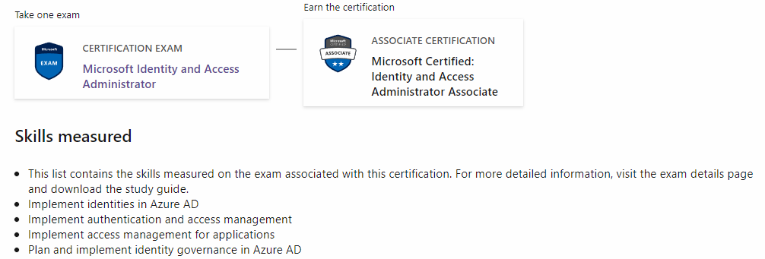
Identity & Access Admin Associate
SC-300

Slide 18
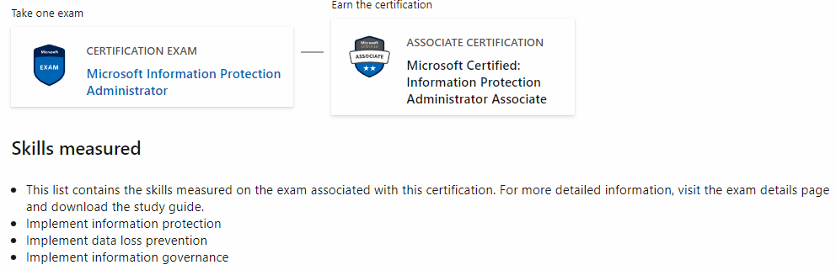
Information Protection Admin Assoc.
SC-400

Slide 19
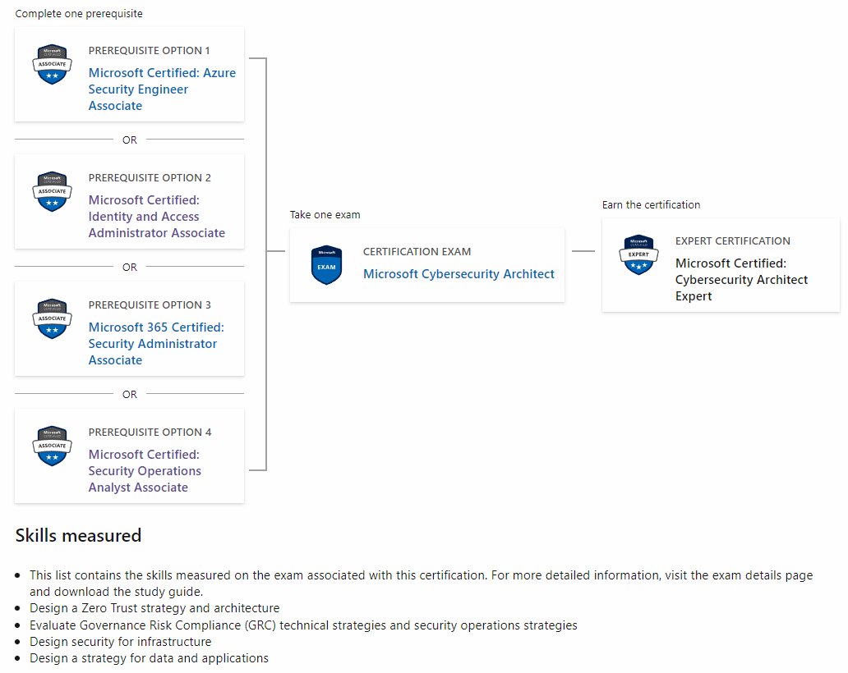
Cybersecurity Architect Expert
AZ-500
SC-100
MS-500

Slide 20

Tim's Certification Study Model

Slide 21
Thank you!
Course materials: timw.info/sc200
Twitter: @TechTrainerTim
Pluralsight: timw.info/ps
Web: timw.info

Slide 22
Microsoft 365 Defender

Slide 23
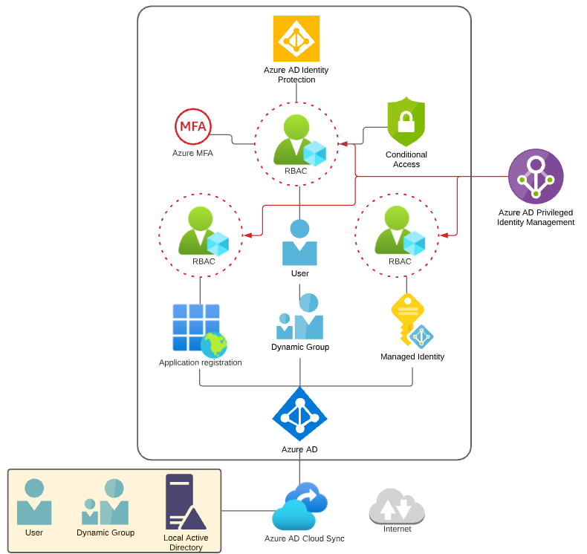
Identity and Access Scenario

Slide 24

Tenant vs. Subscription

Slide 25

Hybrid Identity

Slide 26

Azure Management Scopes
/ Tenant Root

Slide 27
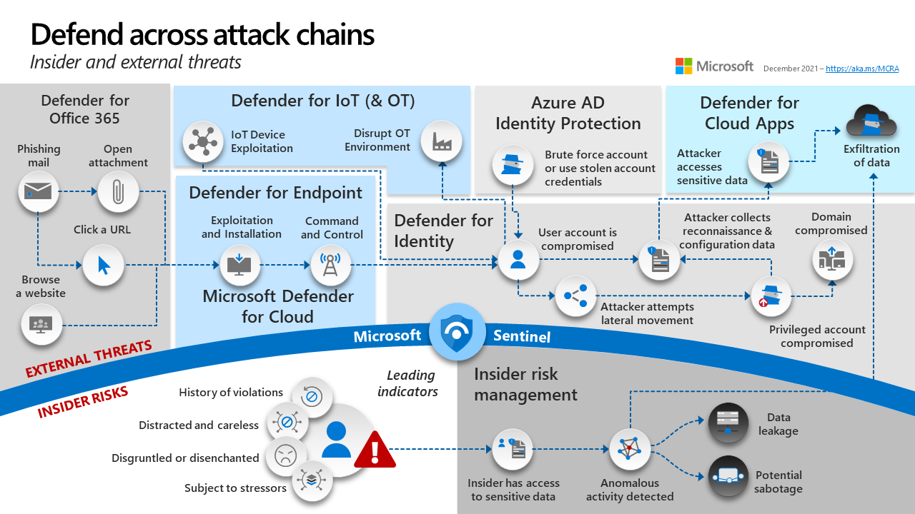
Microsoft 365 Defender

Slide 28
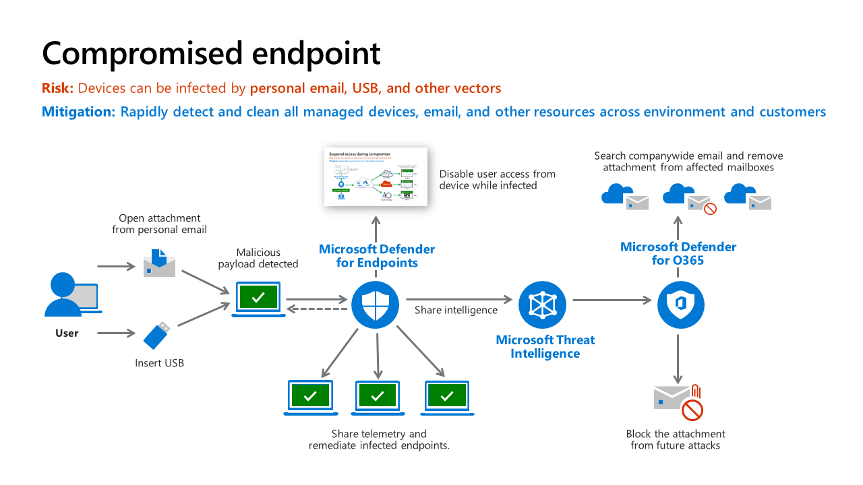
Microsoft Defender for Endpoint

Slide 29
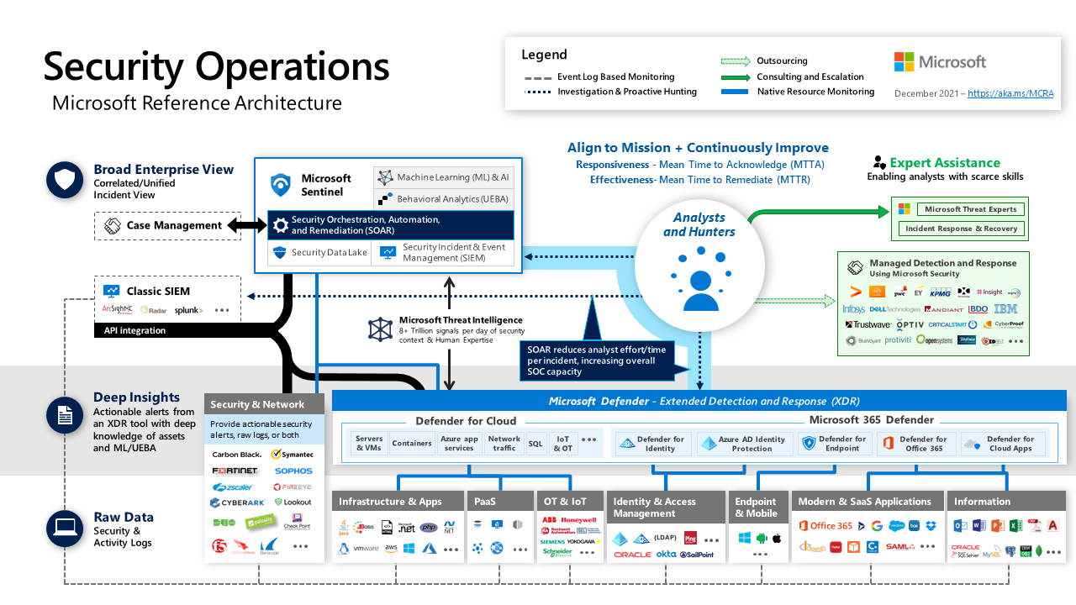
Microsoft 365 Defender

Slide 30
Microsoft 365 Defender

Slide 31
Microsoft Defender for Endpoint

Slide 32
Microsoft 365 Defender in a Modern SOC

Slide 33
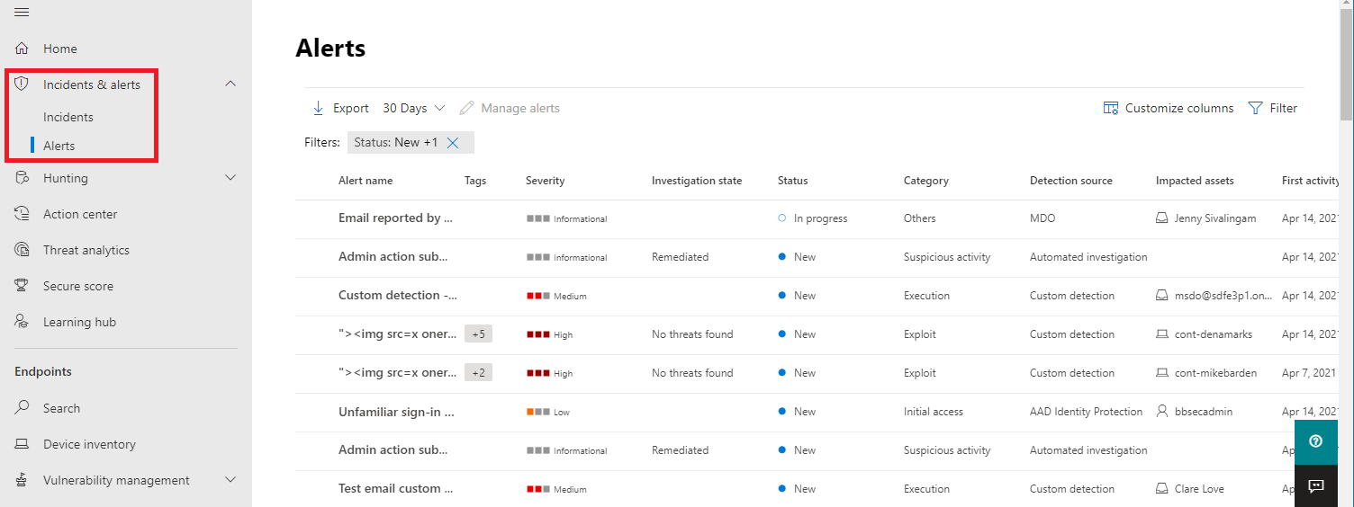
Alerts
Notes:
You can use the Attack simulators to generate Incidents for demonstration purposes
Supporting videos for instructor or student use:
Microsoft Defender for Endpoint: Using the new alert experience
https://www.microsoft.com/en-us/videoplayer/embed/RE4yiO5?rel=0&postJsllMsg=true
(3 minutes)

Slide 34
Manage automated investigations
How the automated investigation starts
Details of an automated investigation
How an automated investigation expands its scope
How threats are remediated
Automation levels in automated investigation and remediation capabilities
Important points about automation levels
Notes:
Resources for instructors to use at their discretion:
Demo link: https://www.microsoft.com/videoplayer/embed/RE4bOeh?rel=0
Follow the annotations and blinking circle for where to click.
Time required: 4 minutes

Slide 35
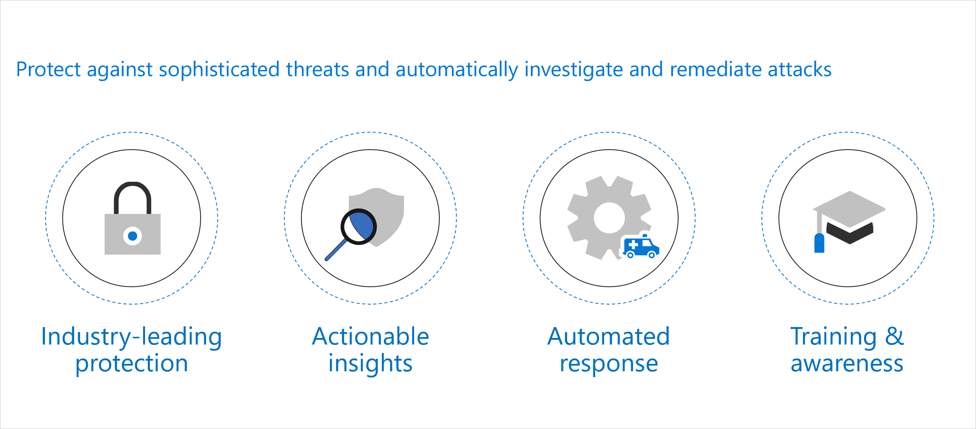
Microsoft Defender for Office 365
Microsoft Defender for Office 365 is a cloud-based email filtering service that helps protect your organization against unknown malware and viruses by providing robust zero-day protection.

Slide 36
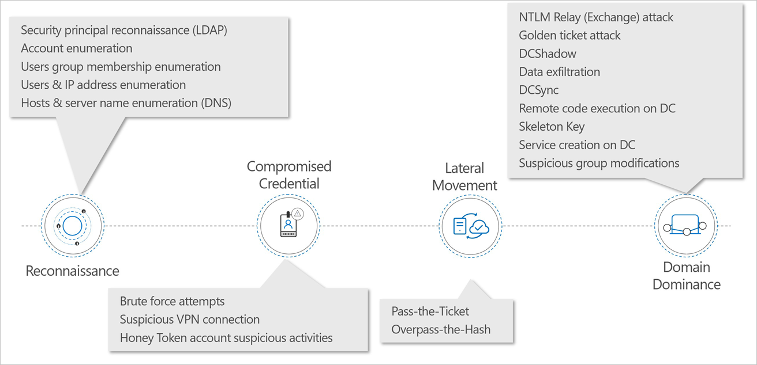
Microsoft Defender for Identity

Slide 37
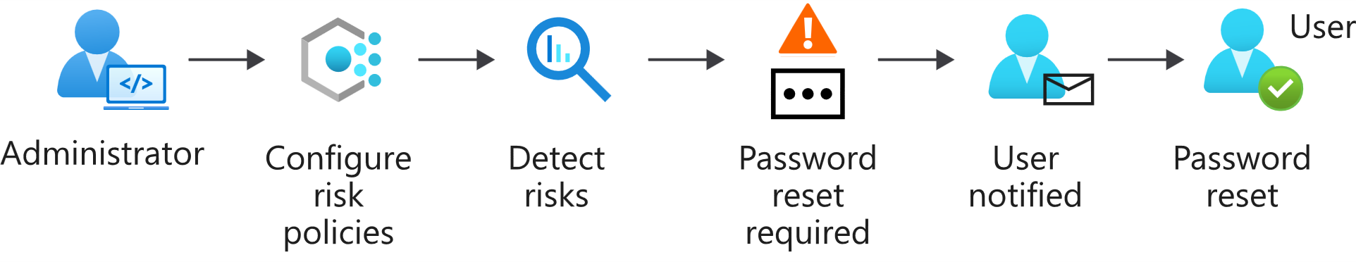
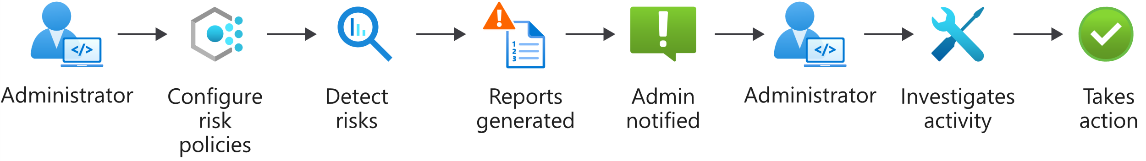
Azure AD Identity Protection

Slide 38
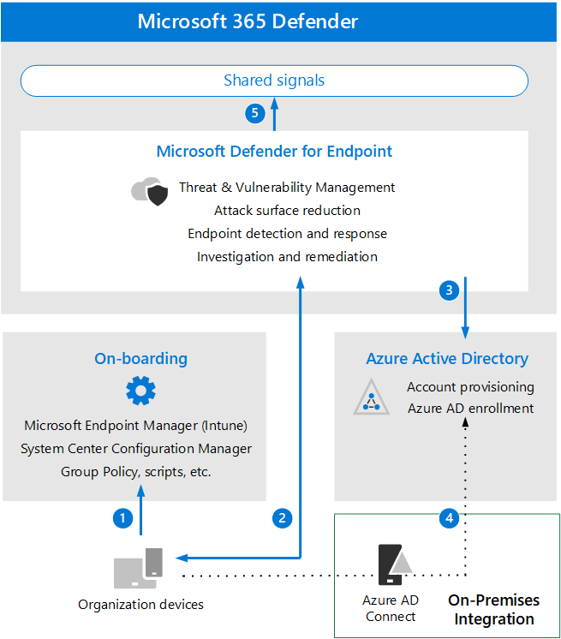
Microsoft Defender for Endpoint
Notes:
The following list describes the illustration steps.
1- Devices are on-boarded through one of the supported management tools.
2- On-boarded devices provide and respond to Microsoft Defender for Endpoint signal data.
3- Managed devices are joined and/or enrolled in Azure Active Directory.
4- Domain-joined Windows devices are synchronized to Azure Active Directory using Azure Active Directory Connect.
5- Microsoft Defender for Endpoint alerts, investigations, and responses are managed in Microsoft 365 Defender.
Supporting videos for instructor or student use as appropriate:
Video: Microsoft Defender for Endpoint – Advanced hunting
https://www.microsoft.com/en-us/videoplayer/embed/RE4bGqo
(6 minutes)

Slide 39

Enable attack surface reduction rules
Sample ASR Rules:
Block executable content from email client and webmail
Block all Office applications from creating child processes
Block Office applications from creating executable content
Block Office applications from injecting code into other processes
Block execution of potentially obfuscated scripts
Use advanced protection against ransomware
Notes:
Instructor demonstration:
Endpoint Manager admin center
Endpoint security policies

Slide 40
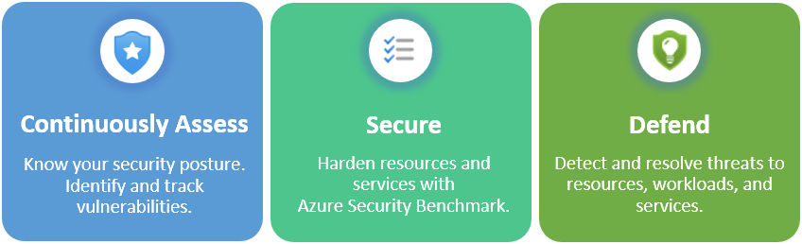
Explain Microsoft Defender for Cloud

Slide 41
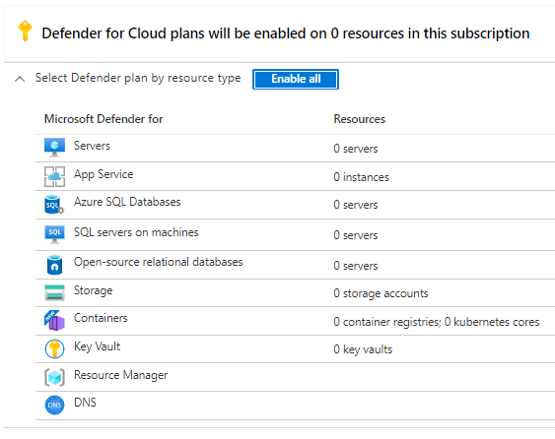
Microsoft Defender for Cloud workload protections
Microsoft Defender for Cloud, brings advanced, intelligent protection to your Azure and hybrid resources and workloads.

Slide 42
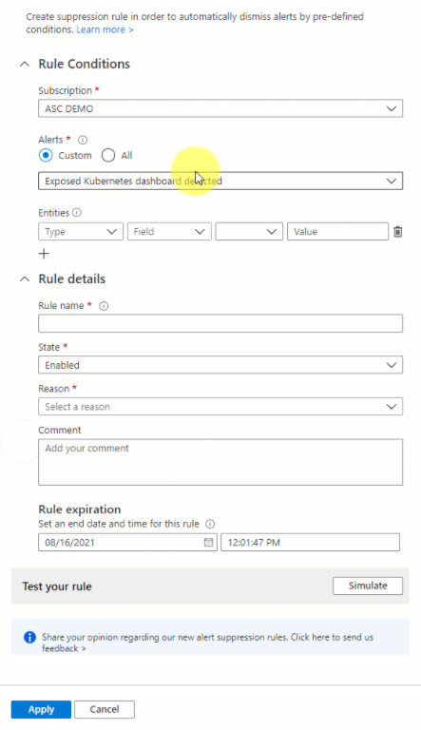
Microsoft Defender for Cloud Suppression Rule
A suppression rule can be useful to suppress alerts that you've identified as false positives or alerts that are being triggered too often to be useful.

Slide 43
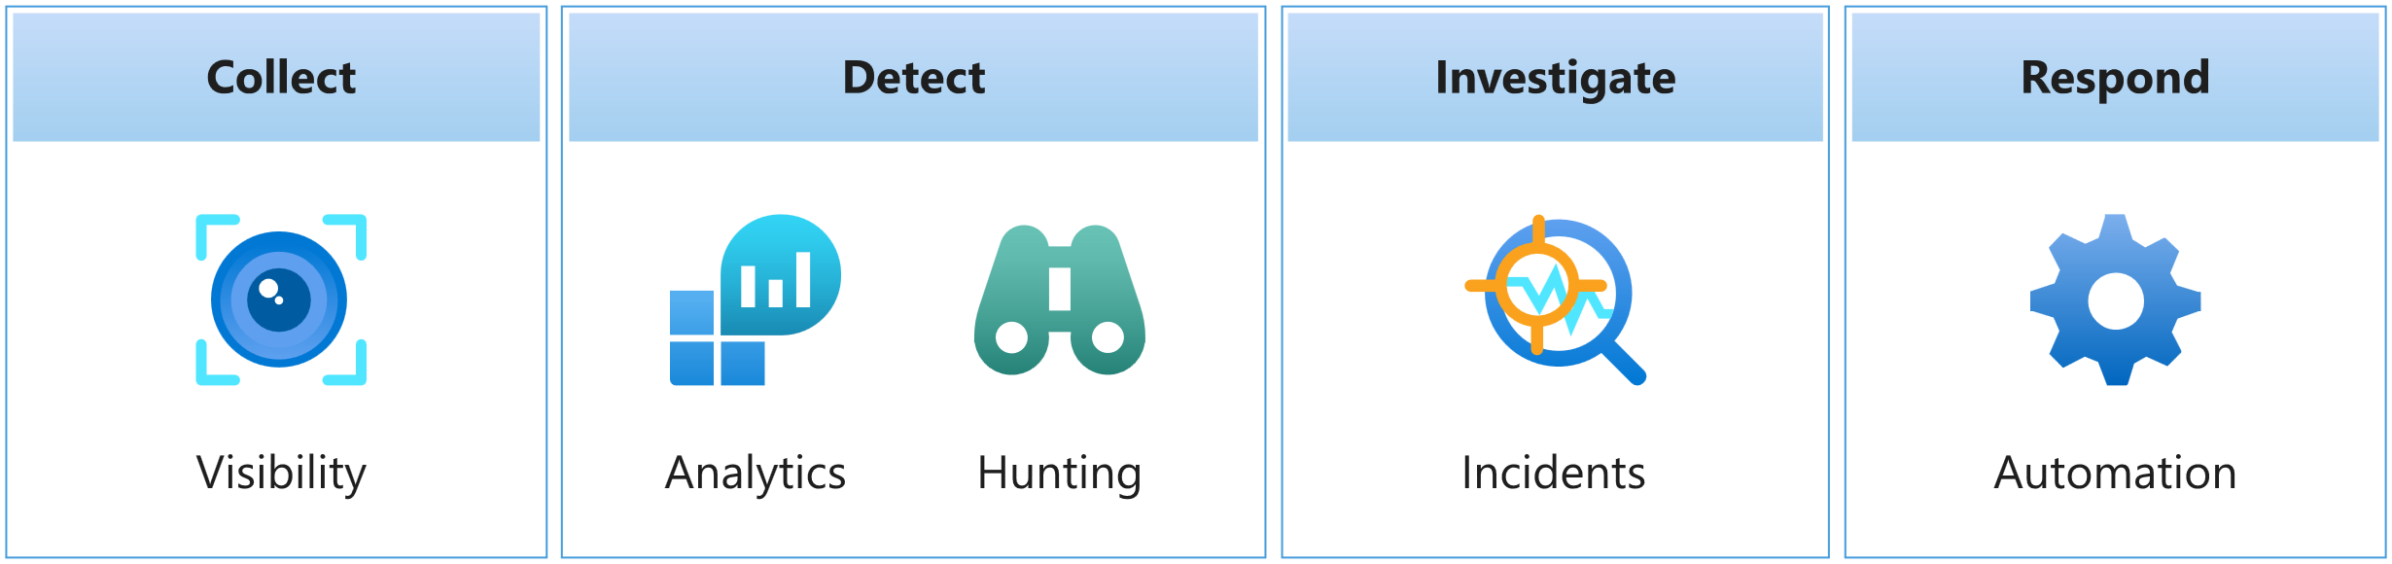
Microsoft Sentinel
Microsoft Sentinel is a cloud-native SIEM. A SIEM system is a tool that an organization uses to collect, analyze, and perform security operations on its computer systems.
Notes:
Supporting videos for instructor or student use:
Interactive guide: Detect and respond to modern attacks with unified SIEM and XDR capabilities
https://aka.ms/AzureSentinel_SOC_InteractiveGuide
(15 minutes)

Slide 44
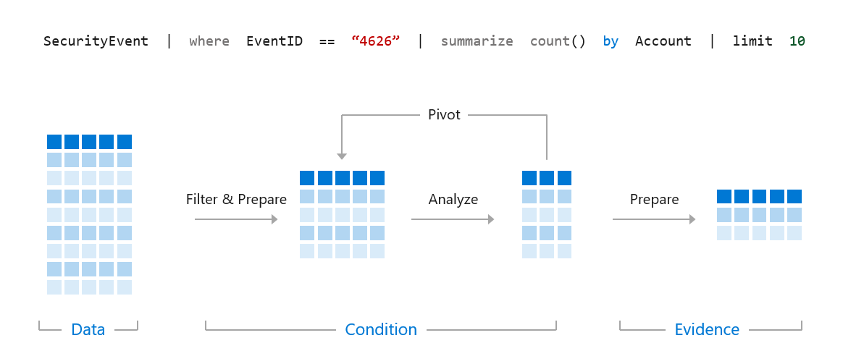
KQL Syntax
A KQL query is a read-only request to process data and return results. The request is stated in plain text, using a data-flow model designed to make the syntax easy to read, write, and automate.
Notes:
A KQL query is a read-only request to process data and return results. The request is stated in plain text, using a data-flow model designed to make the syntax easy to read, write, and automate. The query uses schema entities organized in a hierarchy similar to SQL's: databases, tables, and columns.
It is essential to understand how the results flow through the pipe "|". Everything on the left of the pipe is processed then passed to the right of the pipe.
Instructor demonstration:
Access the Log Analytics demo environment
Query Window

Slide 45
Use the let statement
let timeOffset = 7d;
let discardEventId = 4688;
SecurityEvent
| where TimeGenerated > ago(timeOffset*2) and TimeGenerated < ago(timeOffset)
| where EventID != discardEventId
let LowActivityAccounts =
SecurityEvent
| summarize cnt = count() by Account
| where cnt < 10;
LowActivityAccounts | where Account contains "Mal"
Notes:
Declare and reuse variables
Declare dynamic tables or lists

Slide 46
Use the search operator
search "err"
search in (SecurityEvent,SecurityAlert,A*) "err"

Slide 47
Use the where operator
SecurityEvent
| where TimeGenerated > ago(1d)
SecurityEvent
| where TimeGenerated > ago(1h) and EventID == "4624"
SecurityEvent
| where TimeGenerated > ago(1h)
| where EventID == 4624
| where AccountType =~ "user"
SecurityEvent | where EventID in (4624, 4625)

Slide 48
Use the extend operator
SecurityEvent
| where ProcessName != "" and Process != ""
| extend StartDir = substring(ProcessName,0, string_size(ProcessName)-string_size(Process))
Notes:
Instructor: Demonstrate the extend operator
SecurityAlert
| where TimeGenerated > ago(7d)
| extend severityOrder = case (
AlertSeverity == "High", 3,
AlertSeverity == "Medium", 2,
AlertSeverity == "Low", 1,
AlertSeverity == "Informational", 0,
-1)

Slide 49
Use the order by operator
SecurityEvent
| where ProcessName != "" and Process != ""
| extend StartDir = substring(ProcessName,0, string_size(ProcessName)-string_size(Process))
| order by StartDir desc, Process asc

Slide 50
Use the project operators
SecurityEvent
| project Computer, Account
SecurityEvent
| where ProcessName != "" and Process != ""
| extend StartDir = substring(ProcessName,0, string_size(ProcessName)-string_size(Process))
| order by StartDir desc, Process asc
| project-away ProcessName

Slide 51
Use the join operator
SecurityEvent
| where EventID == "4624"
| summarize LogOnCount=count() by EventID, Account
| project LogOnCount, Account
| join kind = inner (
SecurityEvent
| where EventID == "4634"
| summarize LogOffCount=count() by EventID, Account
| project LogOffCount, Account
) on Account
Notes:
Instructor: Demonstrate
join operator

Slide 52
Query Multiple Workspaces
ADFPipelineRun //Workspace A
| union
workspace("<WorkspaceID for workspace B>").ADFPipelineRun
| summarize CountFailed = countif(Status == "Failed")
TimeStatus = countif(TimeGenerated > ago(90d))
Notes:
Instructor: Demonstrate
join operator

Slide 53
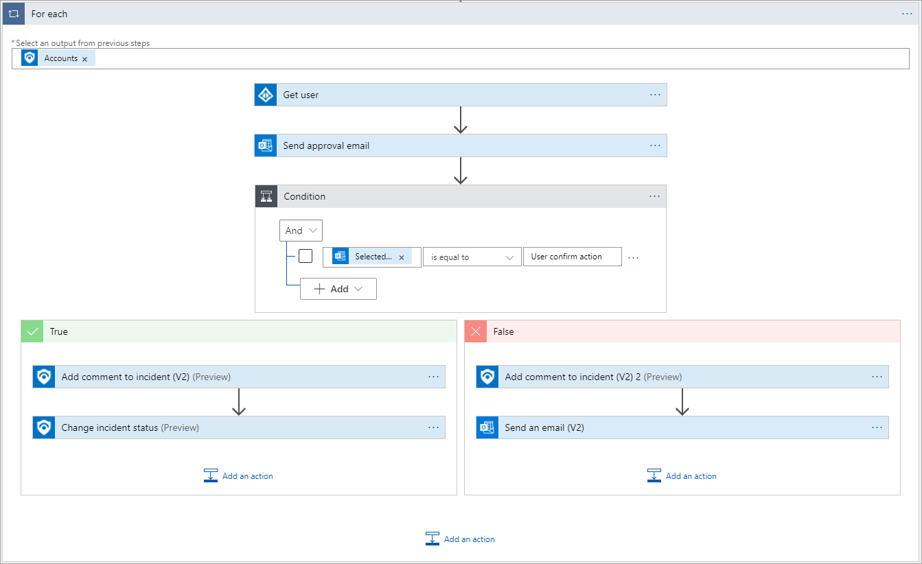
Logic App Visual Designer

Slide 54

Log Analytics

